Slide 1
SEQUENTIAL ATTENTION FOR FEATURE SELECTION
Gwangwoo Kim
Apr. 28, 2023

Slide 2
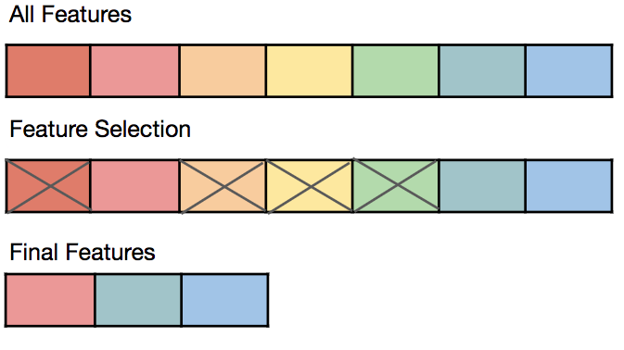
Introduction

Slide 3




Preliminary
Let be the design matrix with unit columns
Let be the response vector with unit norm
Let denote the projection matrix onto col(Xs)
Let denote the projection matrix on col(Xs) perp

Slide 4
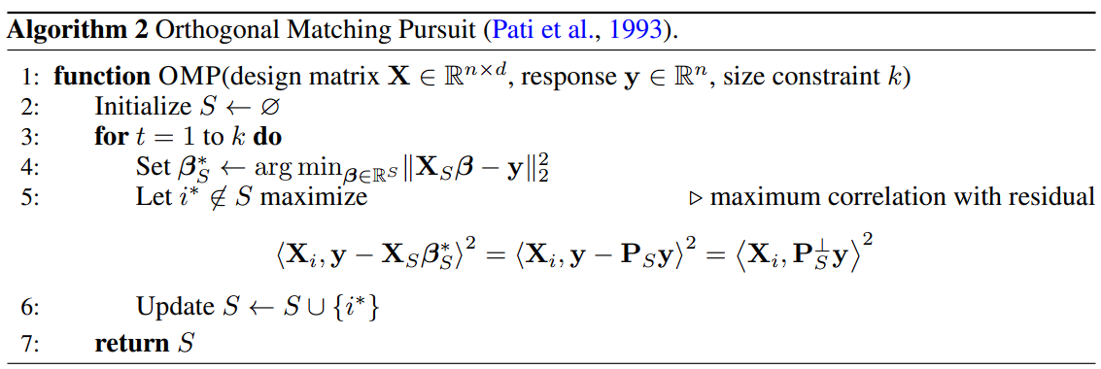
Greedy Forward Selection

Slide 5
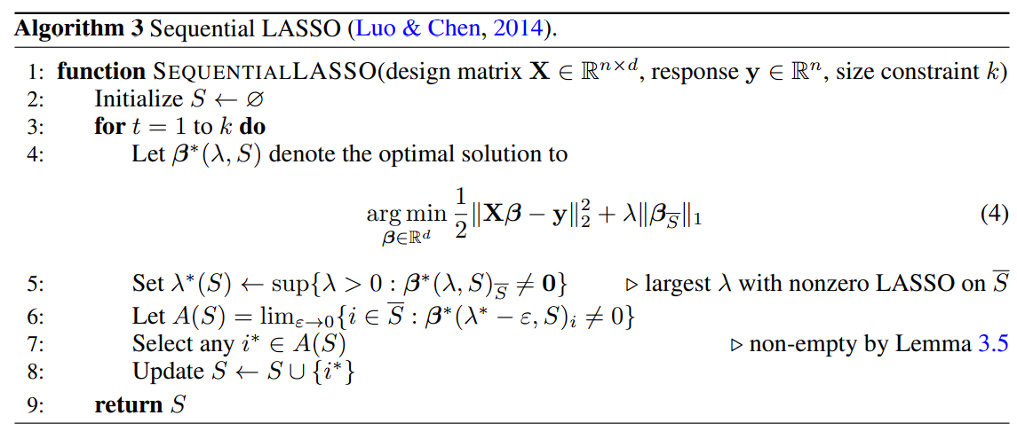
Sequential LASSO
In practice, 𝜆 can simply be set to a large enough value to obtain similar results, since beyond a critical value of 𝜆, the feature ranking according to LASSO coefficients does not change

Slide 6
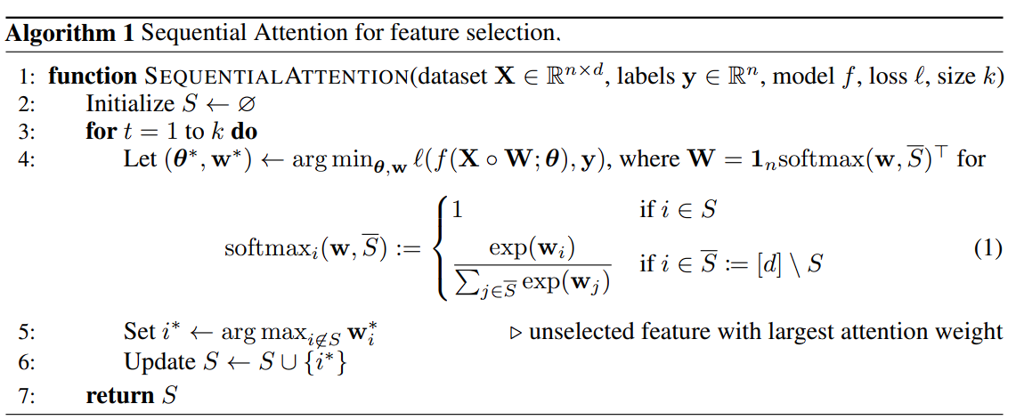
Sequential Attention for feature selection

Slide 7
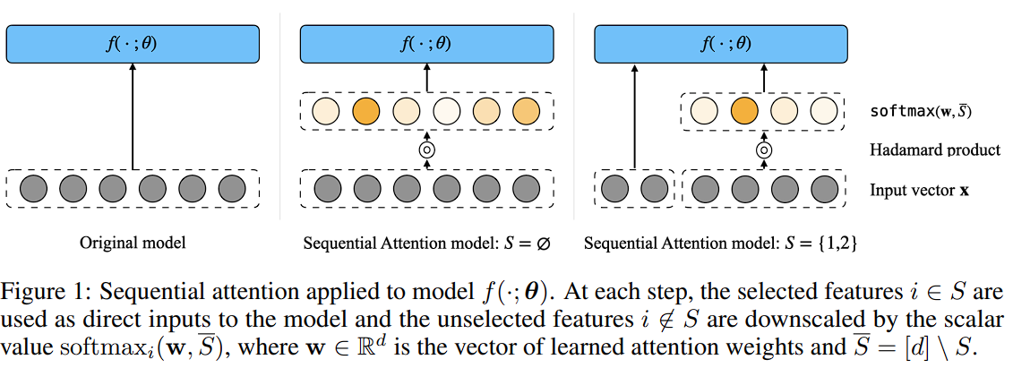
Sequential Attention for feature selection

Slide 8



Equivalence for Least Squares
(Rugularized linear Sequential Attention)
Hoff (2017) shows that is equivalent to

Slide 9
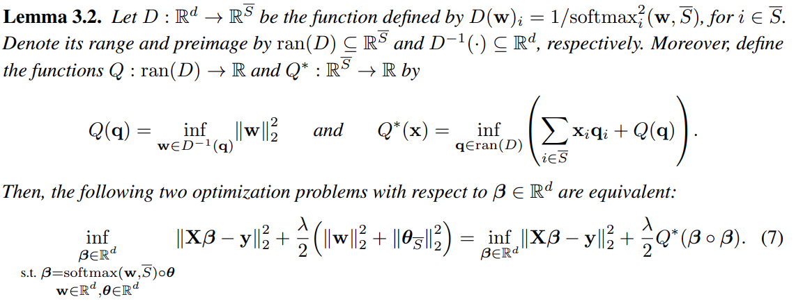
Equivalence for Least Squares

Slide 10
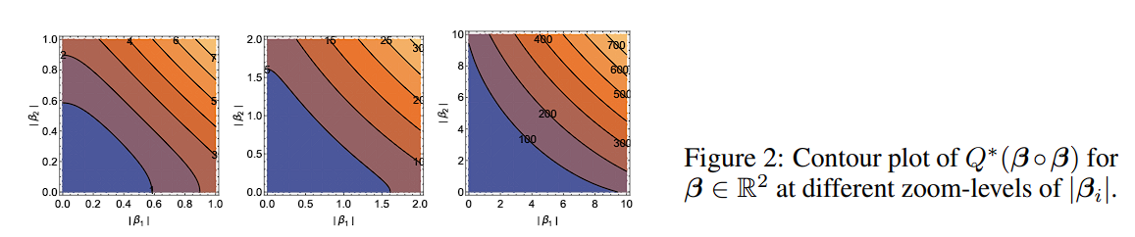
Equivalence for Least Squares

Slide 11
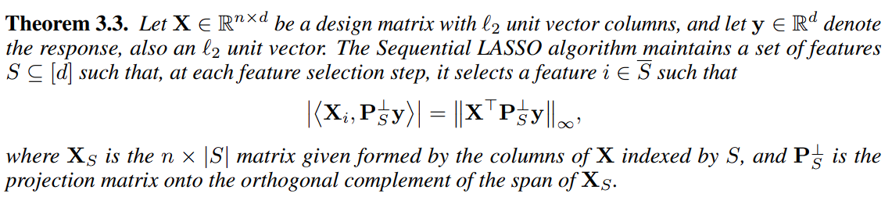
Sequential LASSO and OMP

Slide 12
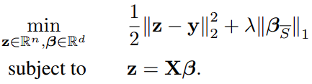

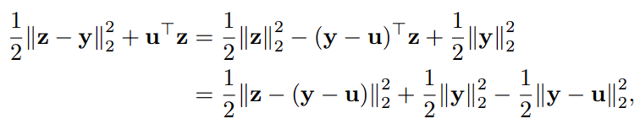
Geometry of Sequential LASSO
which is minimized at z = y − u

Slide 13

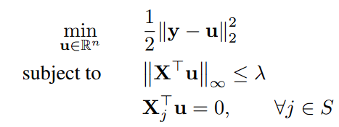
Geometry of Sequential LASSO
Obs 1: if the left of the beta is nonzero any coordinate in S, the value can be made arbitrarily negative.
Obs 2: if the infinite norm of the left is greater than lambda, the value can also be negative.

Slide 14

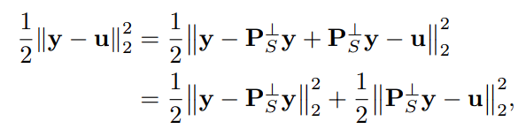
Geometry of Sequential LASSO
Obs 3: The second constraint means u should be in the orthogonal complement of the column space of Xs.
Since is orthogonal to complement of the column space,

Slide 15

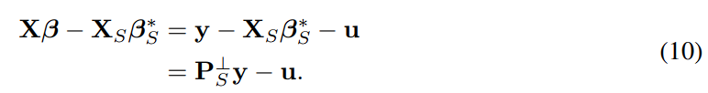
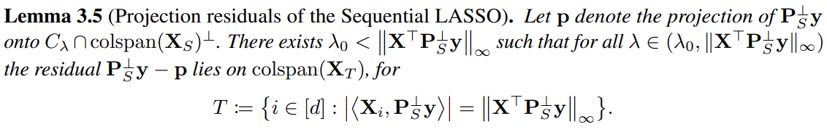
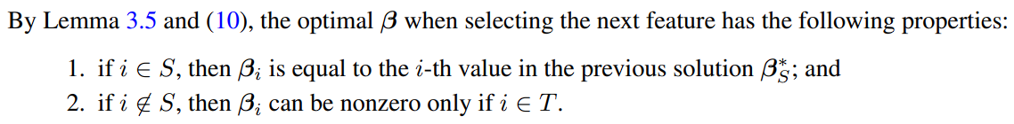
Selection of features in Sequential LASSO
From , we have

Slide 16
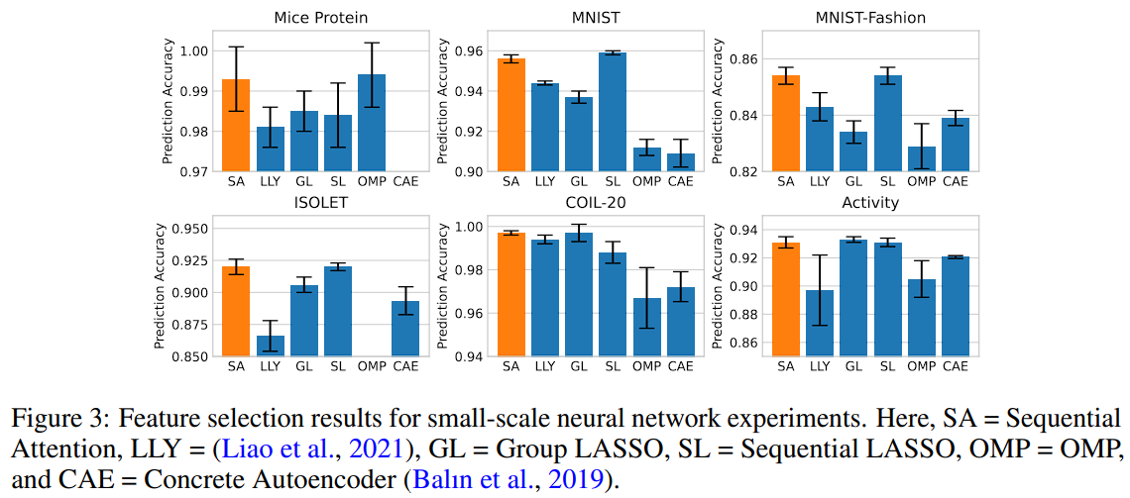
Experiments

Slide 17
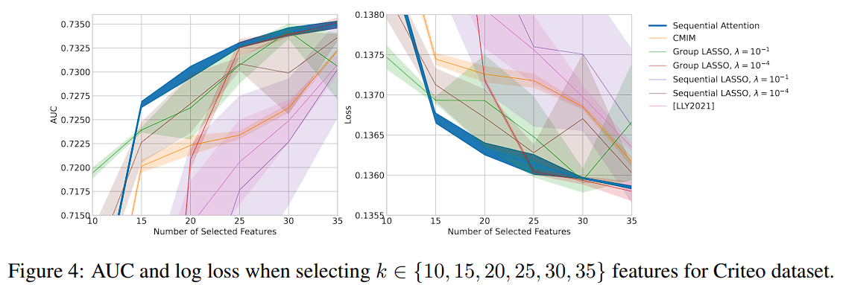
Experiments

